Slide 1


HydroDesktop: An Open Source GIS-Based Platform for Hydrologic Data Discovery, Visualization, and Analysis
Daniel P. Ames, Ph.D. P.E.
Idaho State University
With Jiří Kadlec, Yang Cao, Dinesh Grover and many others…

Slide 2
What is HIS?
The CUAHSI* Hydrologic Information System (HIS) provides web services, tools, standards and procedures that enhance access to more and better data for hydrologic analysis.
http://his.cuahsi.org
*Consortium of Universities for the Advancement of Hydrologic Science, Inc. http://www.cuahsi.org
Notes:
HIS helps you discover and access hydrologic data.

Slide 3
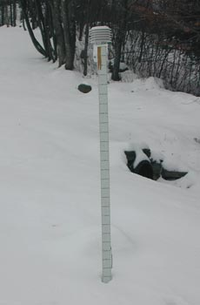
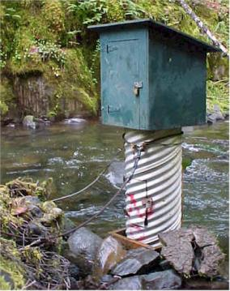
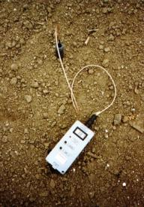
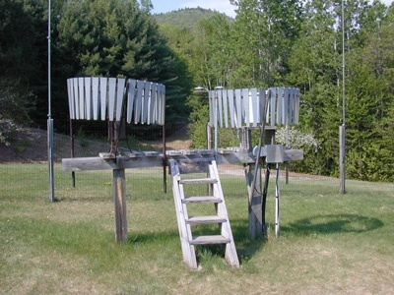
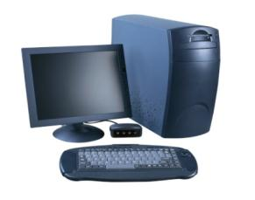
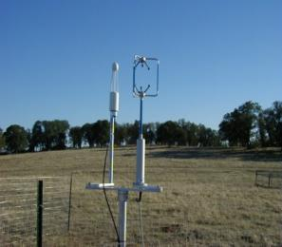
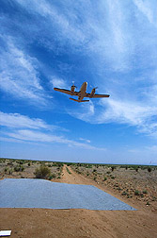
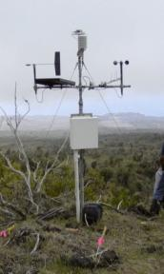
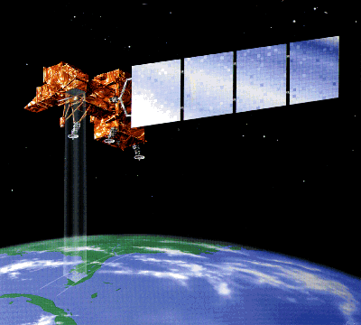
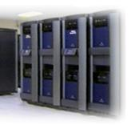
Water Data
Water quantity and quality
Soil water
Rainfall & Snow
Modeling
Meteorology
Remote sensing
Notes:
There are many types of water data.

Slide 4

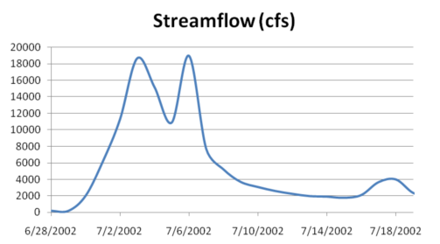
Point Water Observations Time Series
A point location in space
A series of values in time
Notes:
These data are recorded over time to monitor a hydrologic process or property.

Slide 5
The Data Cube – “what-where-when”
Time, T
“When”
t
A data value
3/4/2007
D
4.2
s
“Where”
Cane
Creek
Space, S
V_{i}
“What”
Streamflow
Variables, V
Notes:
The HIS relational database has its origins in the data cube, where a single data value is indexed by a description of what it represents, its location in space, and when it was recorded.

Slide 6
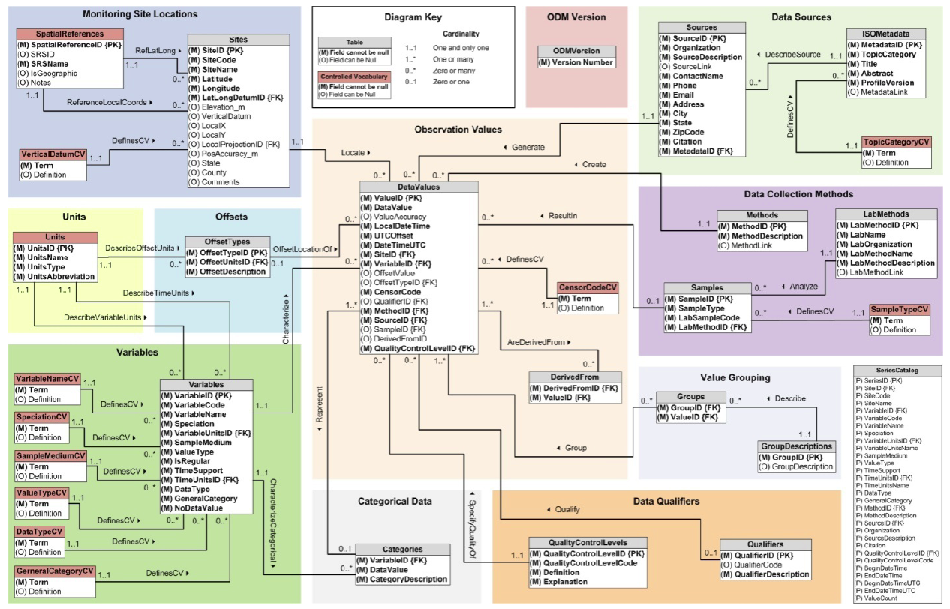
Observations Data Model
Sites
Values and Time
Variables
Horsburgh, J. S., D. G. Tarboton, D. R. Maidment and I. Zaslavsky, (2008), "A Relational Model for Environmental and Water Resources Data," Water Resour. Res., 44: W05406, doi:10.1029/2007WR006392.
Notes:
The DataValues table is at the center of the Observations Data Model, with other tables around it providing additional information using database relationships.

Slide 7
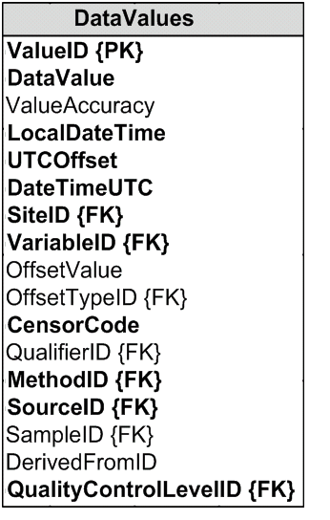
Data Values Table
Time, T
t
v_{i} (s,t)
s
Space, S
V_{i}
Variables, V
Notes:
We represent the data cube with the DataValues table. We store what, where, when, and other information for each data value in the table. (Fields highlighted in bold are required fields.)

Slide 8
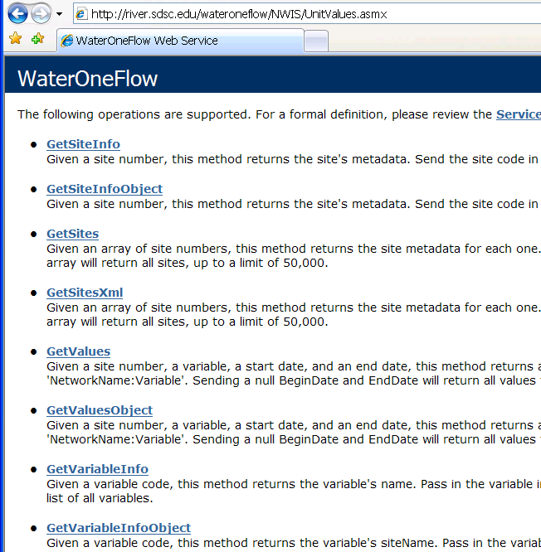
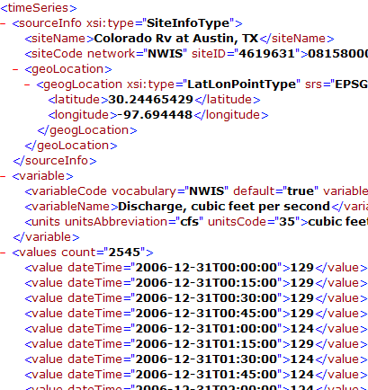
Data Publication: WaterML and WaterOneFlow
WaterML is an XML language for communicating water data
WaterOneFlow is a set of web services based on WaterML
Set of query functions
Returns data in WaterML
NWIS Daily Values (discharge), NWIS Ground Water, NWIS Unit Values (real time), NWIS Instantaneous Irregular Data, EPA STORET, NCDC ASOS, DAYMET, MODIS, NAM12K, USGS SNOTEL, ODM (multiple sites)
Slide from David Valentine
Notes:
8

Slide 9
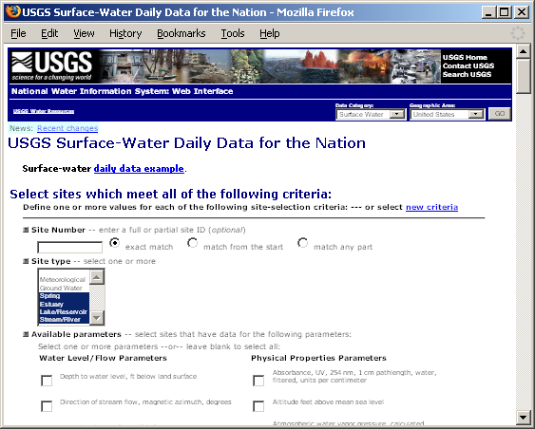
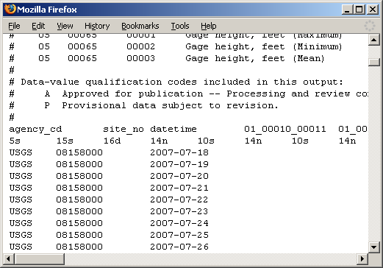
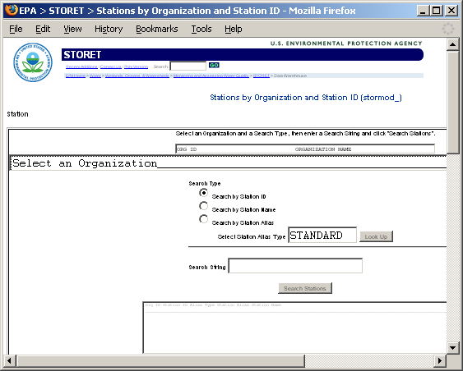
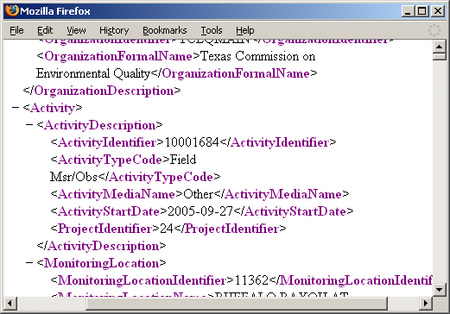
Getting Water Data (the old way)
Different Query Pages
Different Query Responses
Notes:
Much hydrologic data are online. However, each website has a different form for querying data, and each website returns data in a different format.

Slide 10
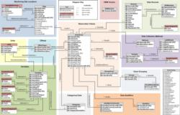
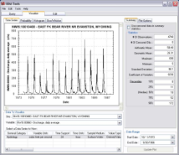
HIS Server
Data Archives
Real-time Sensors
Built for data
Storage
Loading
Analysis
Publication
HIS Software free of charge
ODM and Streaming Data Loaders
HIS Server
Observations Data Model Database
SQL Server
WaterOneFlow Web Service
ODM Tools
Outside Users
Local Users
Notes:
HIS is not just for people who want to get data. It can also be used to help publish data. HIS includes tools to assist with the entire chain of data publication, from storing data streamed in from sensors, to analyzing the data, to publishing the data with WaterOneFlow.

Slide 11
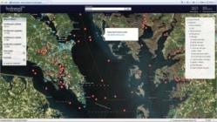

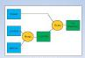
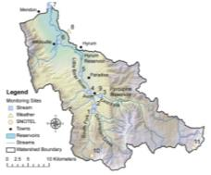
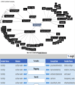
Where does HydroDesktop Fit in CUAHSI HIS?
Discovery
Access
Modeling
Analysis
Hydroseek
HydroDesktop
HydroLink + OpenMI
MATLAB, Excel, GIS, R, …
Web services and Schema
WaterOneFlow and WaterML
GetSites
GetSiteInfo
GetVariableInfo
GetValues
to transmit hydrologic data in a standard way
Observatories
Data repository
Service Registry
3rd-Party Servers
publication and archival of field data
HIS Server
HIS Central
catalog hydrologic data services and metadata
include data from others
ODM
store and share hydrologic data
An internet based system to support the sharing of hydrologic data comprising databases connected using the internet through web services as well as software for data discovery, access and publication.
Notes:
The CUAHSI Hydrologic Information System (CUAHSI-HIS) provides web services, tools, standards and procedures that enhance access to more and better data for hydrologic analysis.
The web services use an XML based format for communicating hydrologic data, called WaterML. HIS web services support access to National Datasets such as the USGS National Water Information System (NWIS) and EPA Storage and Retrieval System (STORET), in a standard way. Users anywhere with access to the internet can save their data in a relational database format, called ODM, and register it with CUAHSI HIS to publish their data. Popular software for working with data, such as Excel, MATLAB and a variety of computer programming languages can access HIS data directly using web services. This lets users work with familiar software rather than having to learn something new.

Slide 12




Where does HydroDesktop Fit in HIS
Internet based system to support the sharing of hydrologic data comprised of hydrologic databases and servers connected through web services and software for data publication, discovery and access.
Metadata
CUAHSI
HIS
Sharing hydrologic data
Data Discovery and Integration
HIS Central
Data
Analysis
HydroServer
WaterML
GML
OGC Services
HydroDesktop
Data Publication
Data Synthesis and Research
ODM
Geo Data
Support
EAR 0622374

Slide 13
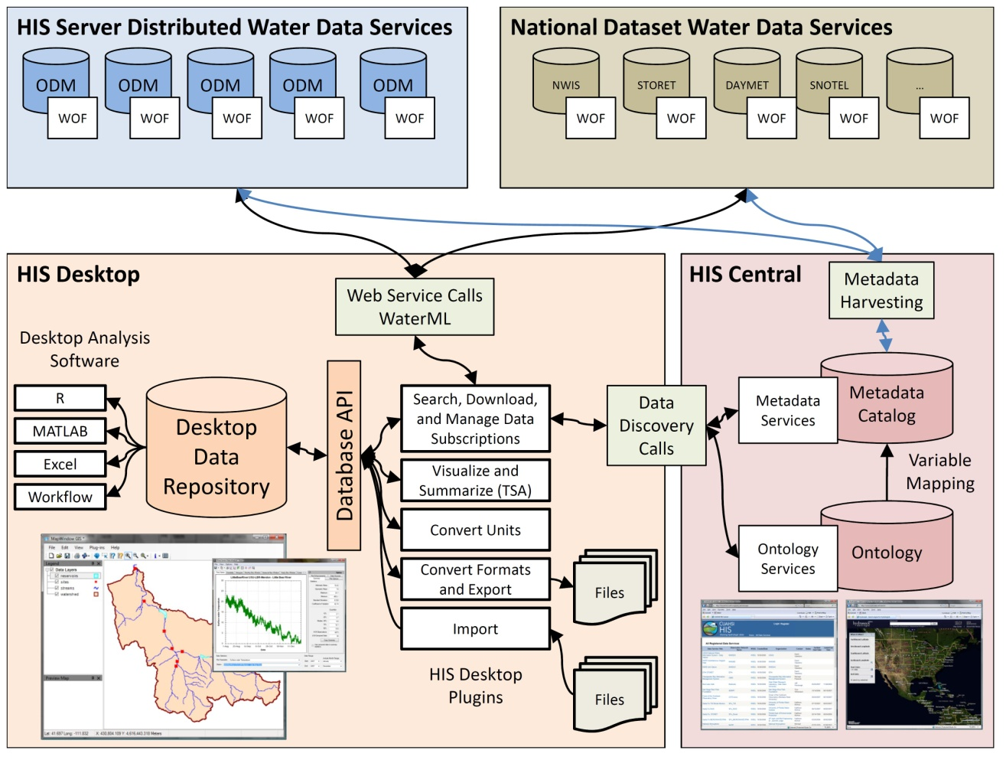

Notes:
HydroDesktop will be a key component of the HIS Project and serves as a desktop client to provide access to HIS Services. HydroDesktop will include capabilities for data discover, download, visualization, modification and export through a simple open source GIS based desktop application.

Slide 14
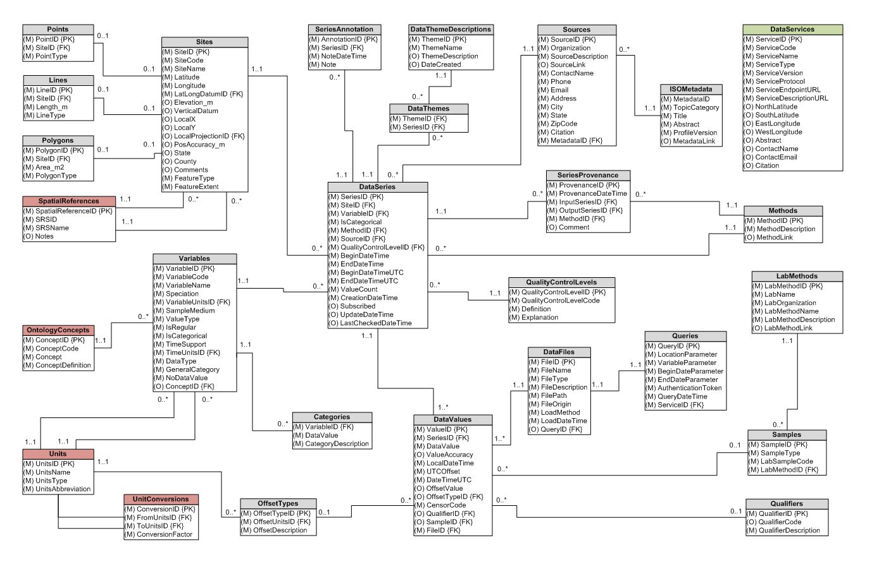
HydroDesktop Database Structure

Slide 15
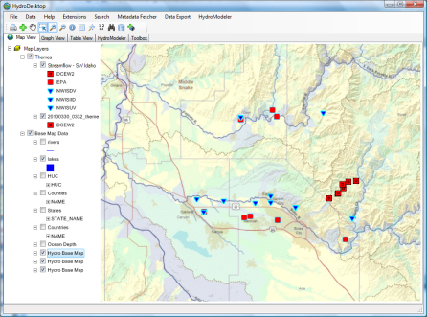

CZO Data System Overview
CZO Central
CZO HydroDesktop
GetSites
GetSiteInfo
GetVariableInfo
GetValues
WaterML
Data Store
WaterOneFlow
Web Service
Harvester
ASCII text
Standardized web based display
Boulder
Shale
Sierra
Luquillo
Jemez
Christina
CZO Servers

Slide 16
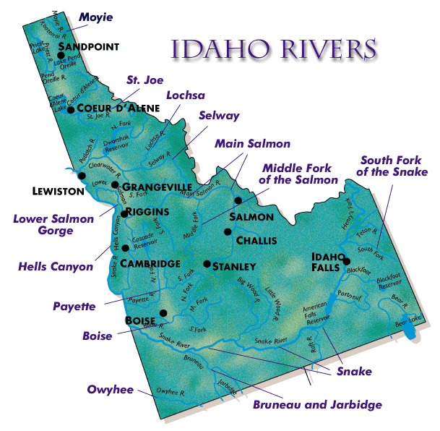
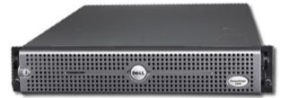
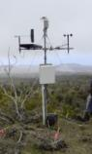


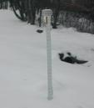

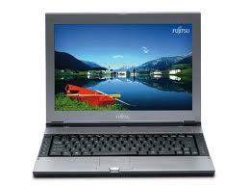
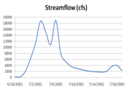

Data series transfer to HIS server(s)
Registration of dataset metadata with HIS Central
Searching for metadata on HIS Central
Downloading data series from servers
IDAHO Point Observation Data Flow
University of Idaho HIS Server
Salmon River Streamflow Data
Evaporation Data
Idaho State University HIS Server
San Diego Super Computer Center HIS Central Catalog
Boise State University HIS Server
Dry Creek Experimental Watershed Data
Portneuf River Streamflow Data
HydroDesktop can then be used to perform visualization and analysis on these data combined with GIS and other data collected from other HIS servers.

Slide 17

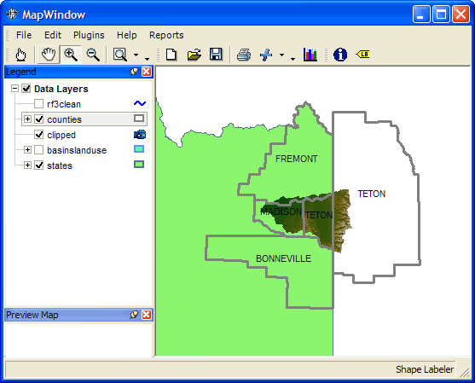








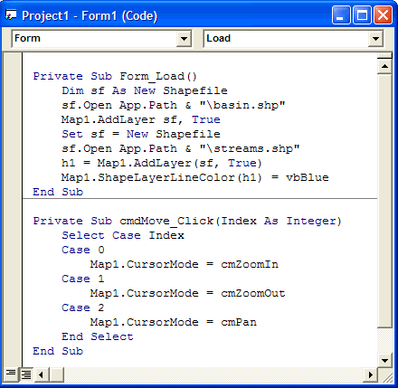

How Open Source Works
HIS
INRA
CZO

Slide 18
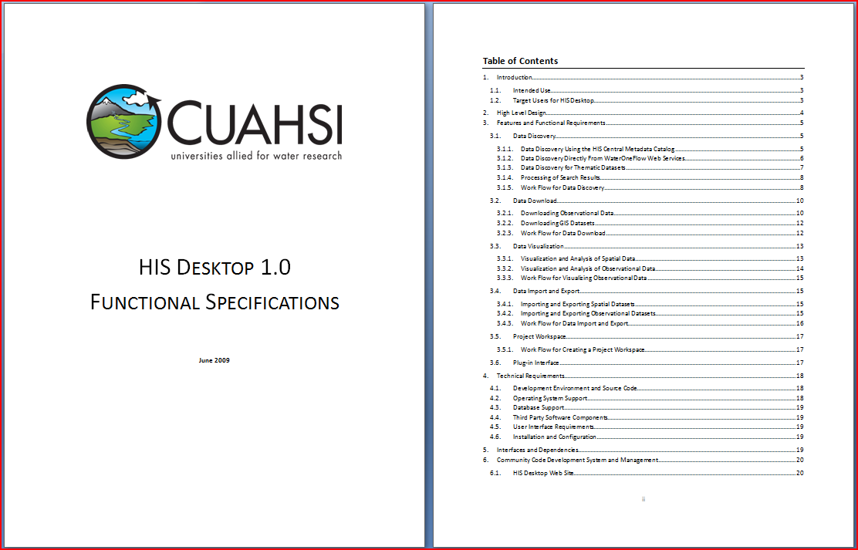
HydroDesktop Design Specifications available at www.hydrodesktop.org

Slide 19
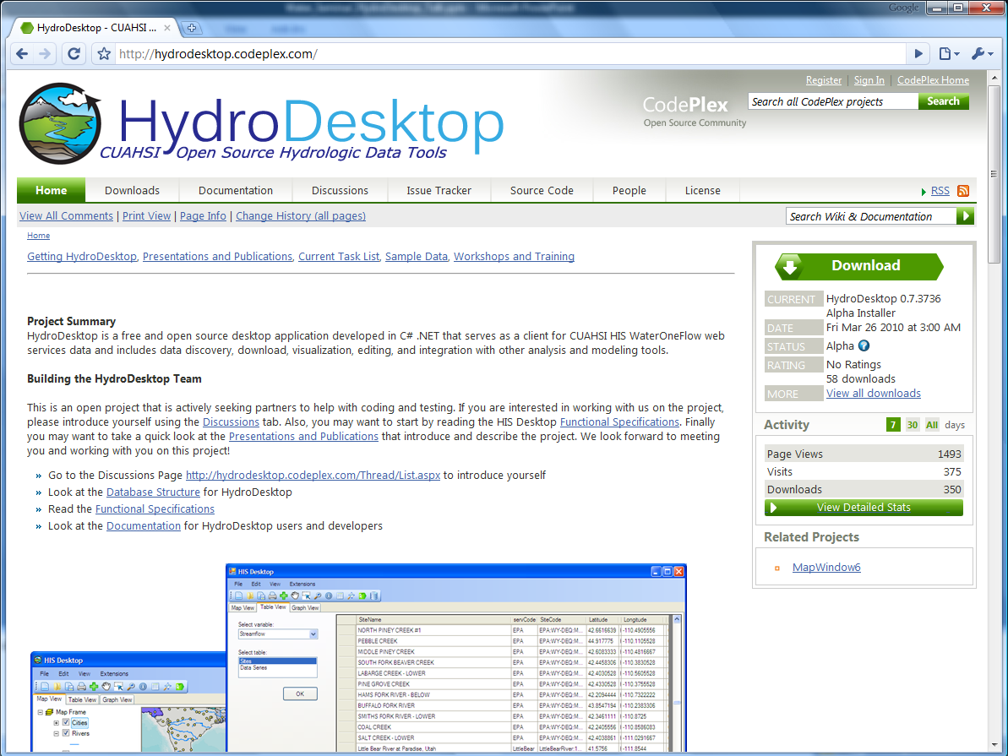

Slide 20
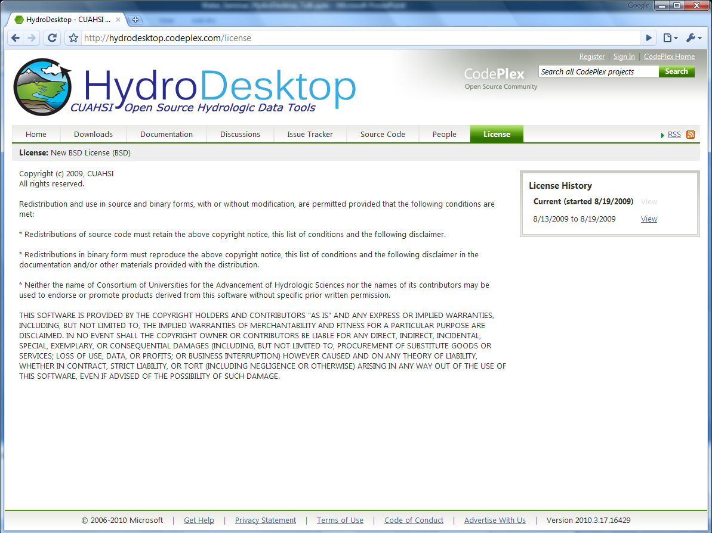

Slide 21
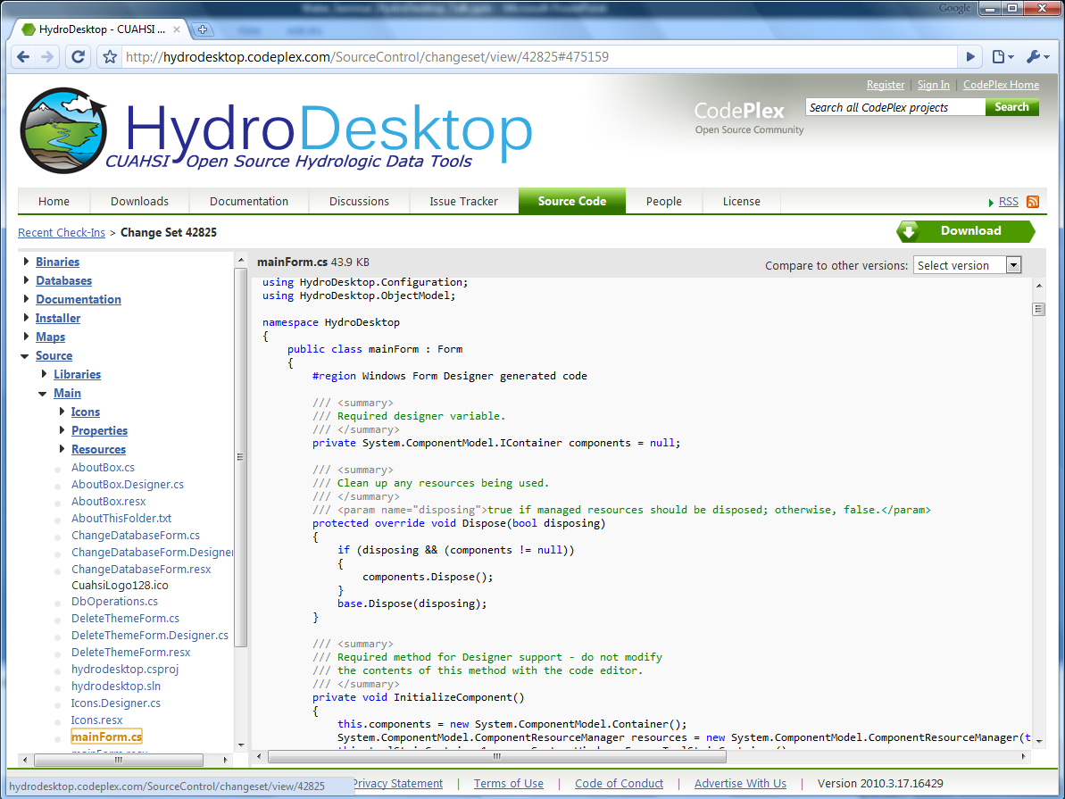

Slide 22
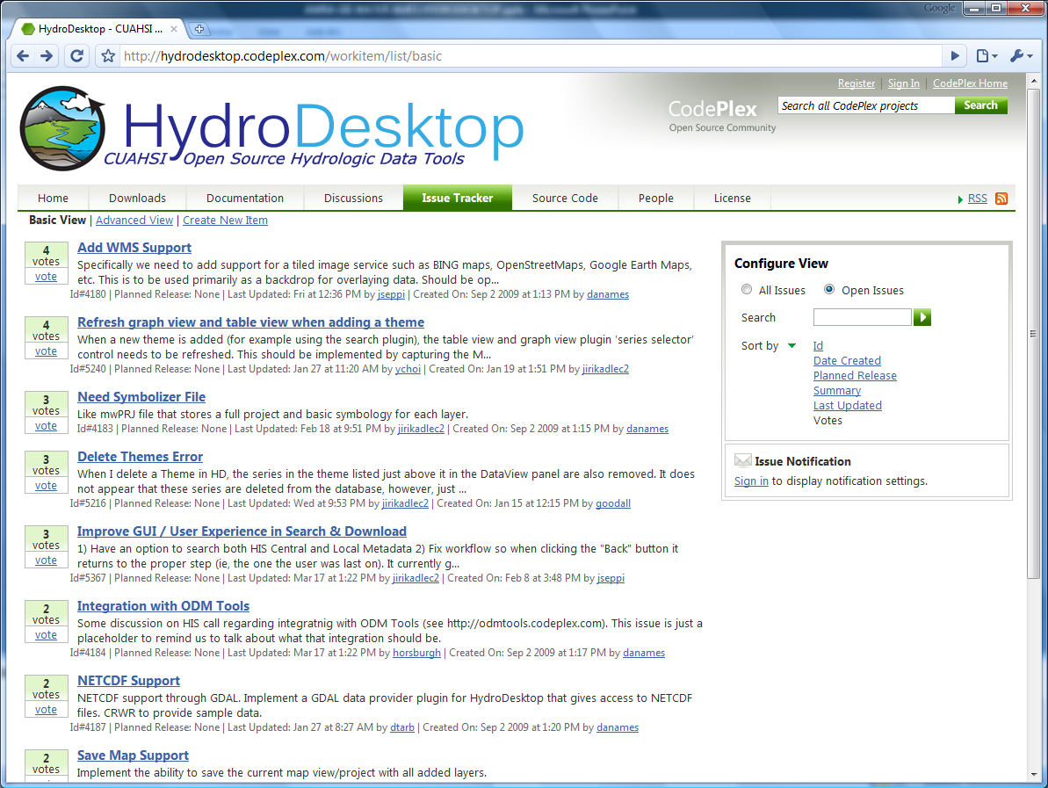

Slide 23
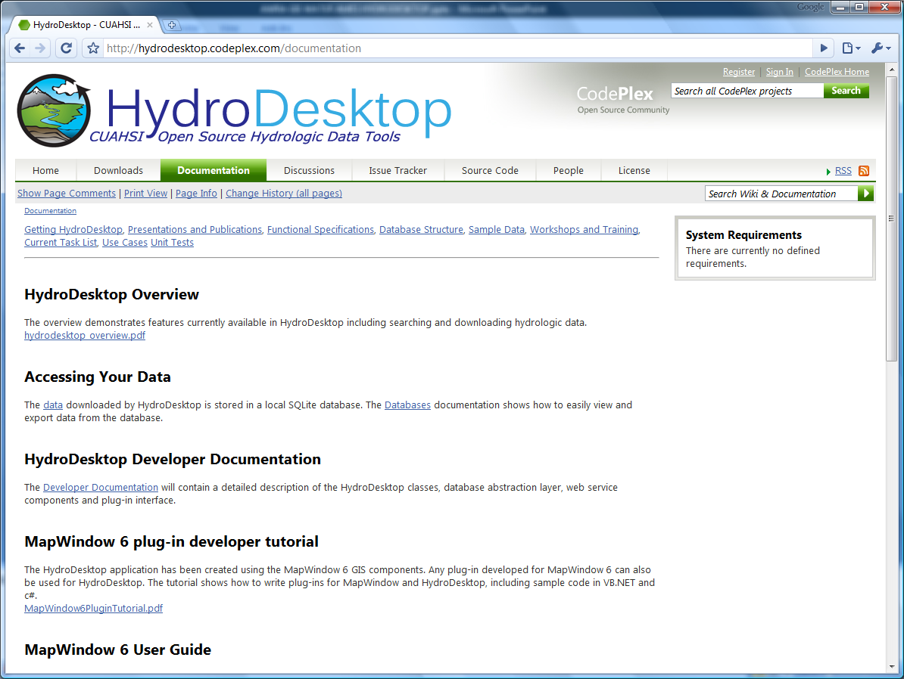

Slide 24
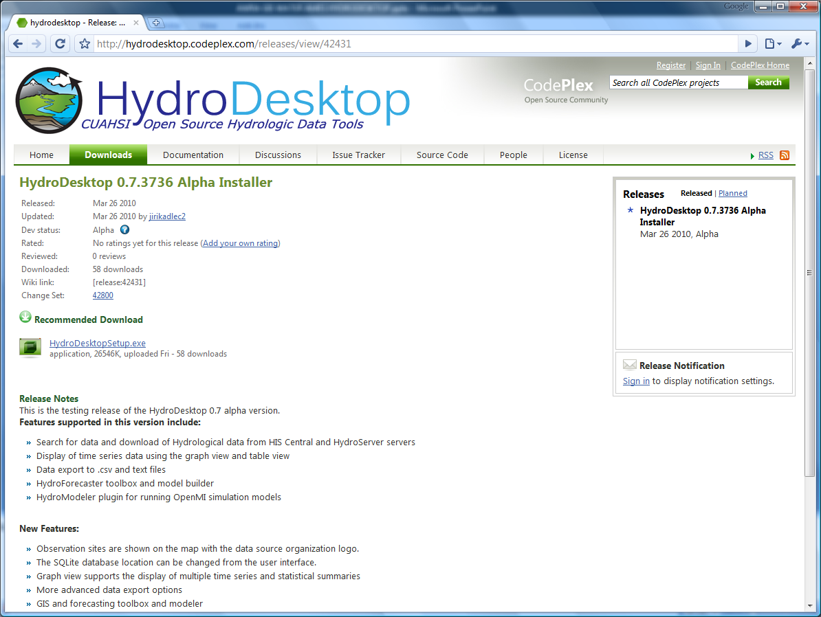
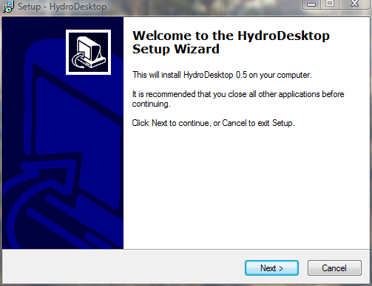

Slide 25
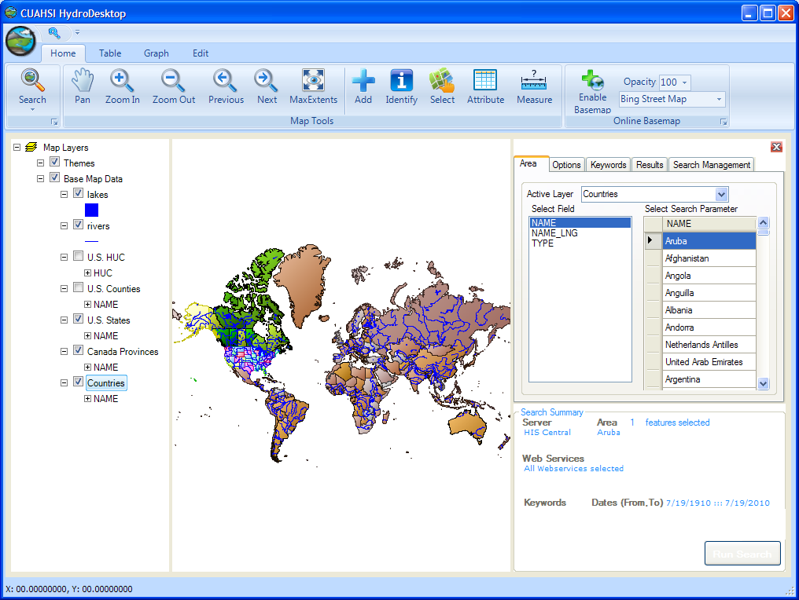
Ribbon
Map Layers
Map
Data Search

Slide 26
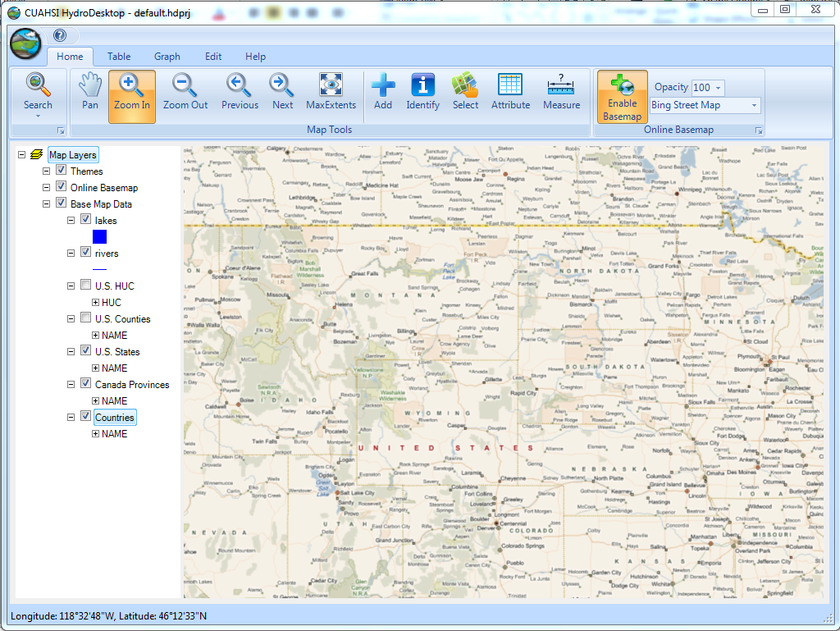
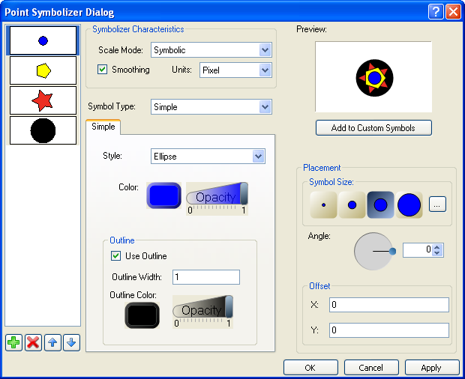
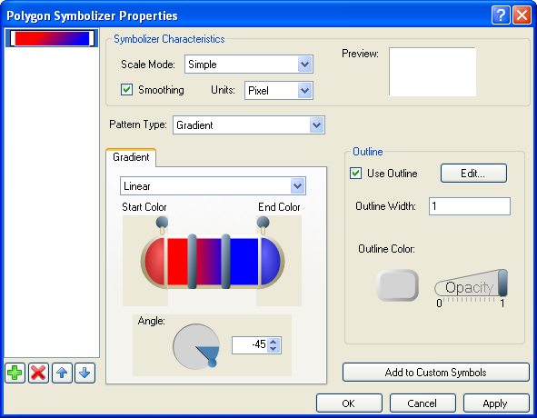
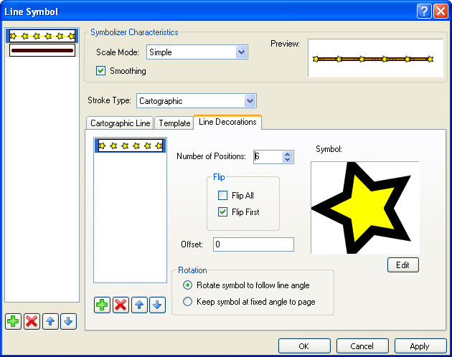
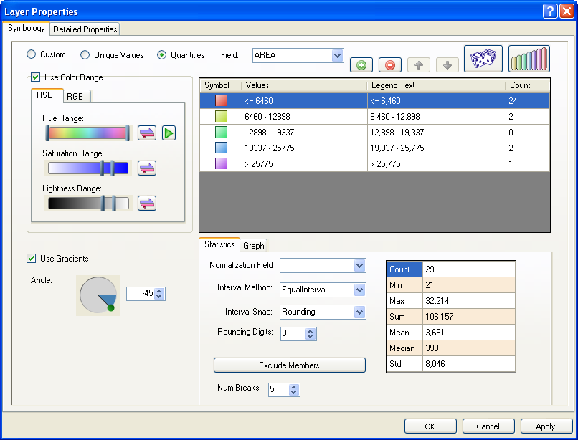
HydroDesktop GIS Capabilities
GIS
Add shapefiles to map
Change symbology and labels
Print and export map
GIS toolbox and Modeler

Slide 27

HydroDesktop Data Search
Search Criteria
Region
Keywords (variable)
Time range
Web services
Example:
Boise watershed, discharge, 2000 - 2009
Notes:
User can search for available data by geographic region, variable, time range and web service. The variable, time range and web service criteria are optional.

Slide 28

HydroDesktop Data search – select region
Region selection
Draw bounding box
Select polygons
Select State
Select County
Select HUC Code
Notes:
User can search for available data by geographic region, variable, time range and web service. The variable, time range and web service criteria are optional.

Slide 29
HydroDesktop Data search – select keywords
Notes:
One or more keywords can be selected. The list of available keywords is retrieved from HIS Central

Slide 30

HydroDesktop Data search – download results

Slide 31



Graphing Capabilities

Slide 32


Tabular Data View

Slide 33


HydroDesktop Plug-in Development
Existing plugins
Search and Download
Graph View
Data Export
Metadata Fetcher
HydroModeler (Open MI)
HydroDesktop.exe
DotSpatial.dll
HydroDesktop.Database.dll
See “Documentation” Link on hydrodesktop.codeplex.com to learn how to write a plug-in.
CZO
HIS
OpenMI
HydroDesktop
Notes:
The functionality of HydroDesktop can be extended by plug-ins. Each plug-in needs to reference the library MapWindow.dll and implement the MapWindow 6 plugin interface. Any existing MapWindow 6 GIS plug-in can be used as a HydroDesktop plug-in. To easily access data from the HydroDesktop local database, a plugin can use functions from the HydroDesktop.Database.dll library (data abstraction layer)

Slide 34



OpenMI HydroModeler

Slide 35

OLAP Data Cube Reanalysis and visualization:

Slide 36

Integration with “R” Statistics Package

Slide 37



Future: Integrated Time Series Modeling + GIS Environment
NOAA Coastal Services Center

Slide 38
HydroDesktop: An Open Source GIS-Based Platform for Hydrologic Data Discovery, Visualization, and Analysis
Daniel P. Ames, Ph.D. P.E.
Idaho State University
With Jiří Kadlec, Yang Cao, Dinesh Grover and many others…

